Slide 1
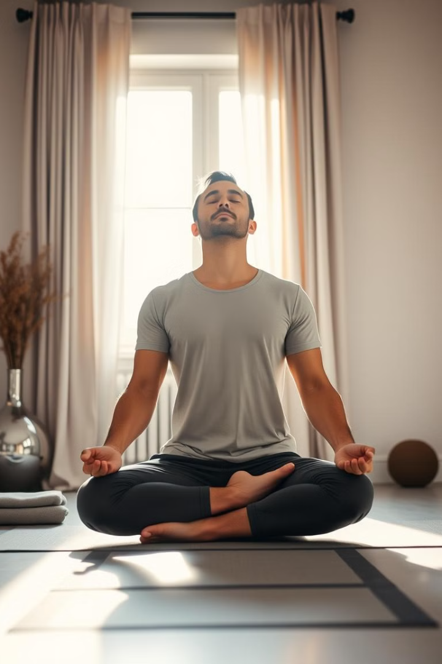
Yoga Website: Your Path to Fitness
Welcome to our yoga website! We help you achieve your fitness goals. Our site personalizes exercises and courses for you. We are here to guide your wellness journey.

Slide 2



Understanding Your Yoga Needs: Input & Personalization
We take your input to tailor your experience. Tell us your exercise preferences. Choose your skill level for each asana.
Our system adapts to your needs. We provide a personalized yoga plan. This plan helps you reach your fitness aspirations.
Personal Input
Personalized Plan
Tell us your exercise preferences.
Our system adapts to your needs.

Slide 3
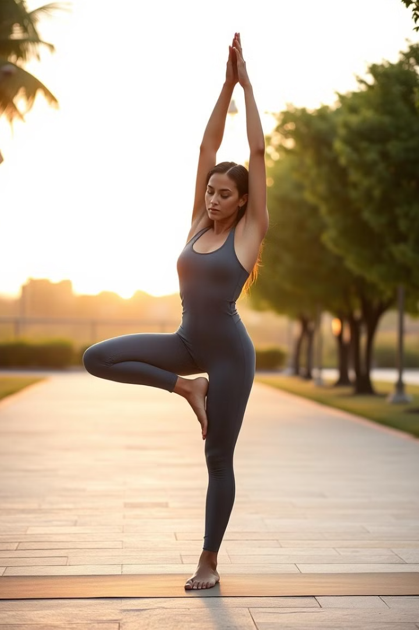



Find Your Perfect Asana: Exercise Suggestions
Seeking a specific pose? Ask for a particular asana. We offer relatable exercises. These exercises will enhance your practice.
Our AI provides suitable suggestions. Explore new yoga styles and poses. Expand your yoga knowledge with us.
Request Asana
Tell us a specific pose.
Relatable Exercises
We provide options to enhance your practice.
AI Suggestions
Explore new styles and poses.

Slide 4
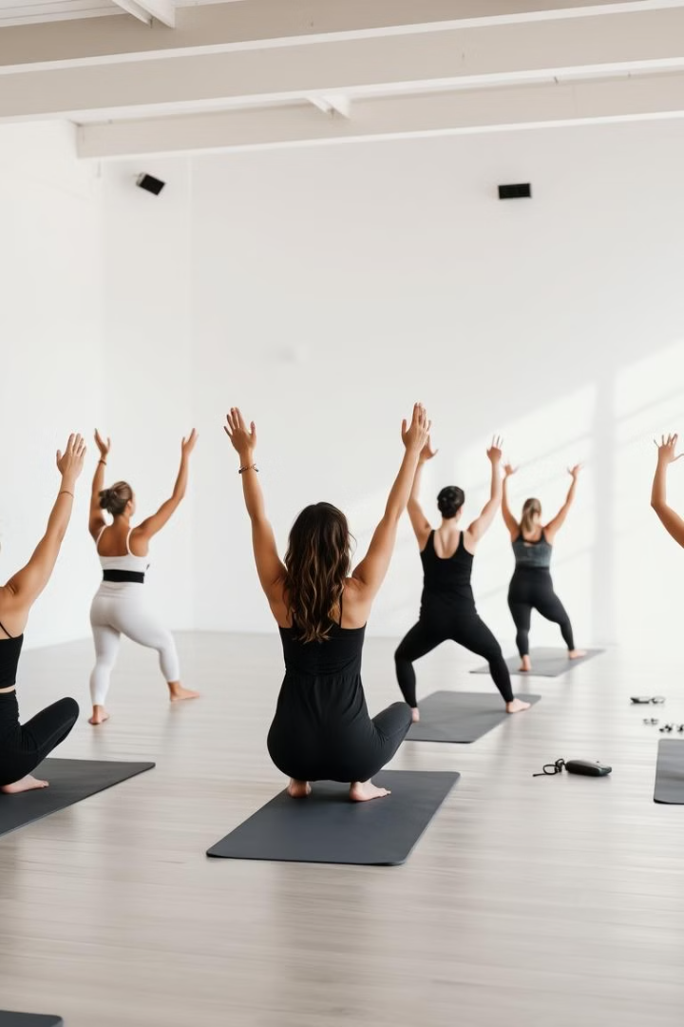
Explore Our Diverse Yoga Courses
We offer a variety of yoga courses. These are suitable for every skill level. Choose what suits you.
Our platform caters to beginners and advanced practitioners alike. Enjoy sessions from our trained instructors. Get personal attention and support.
1
Skill-Based Courses
2
Variety
Courses for every skill level.
Enjoy sessions from trained instructors.
3
Personal Attention
Get support to help you on your journey.

Slide 5
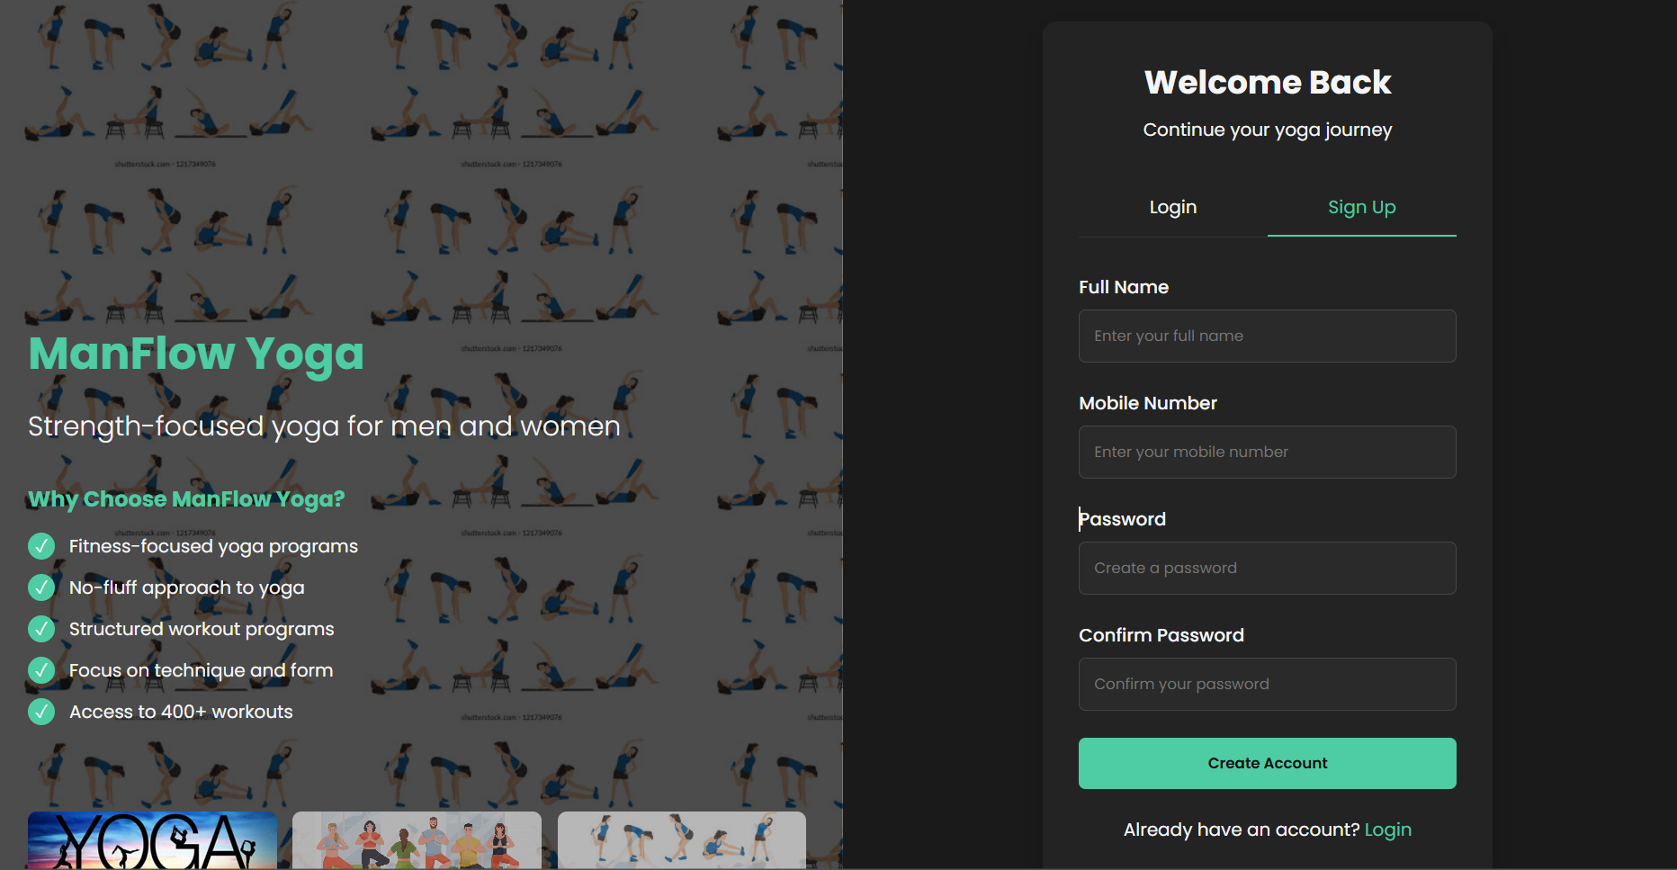
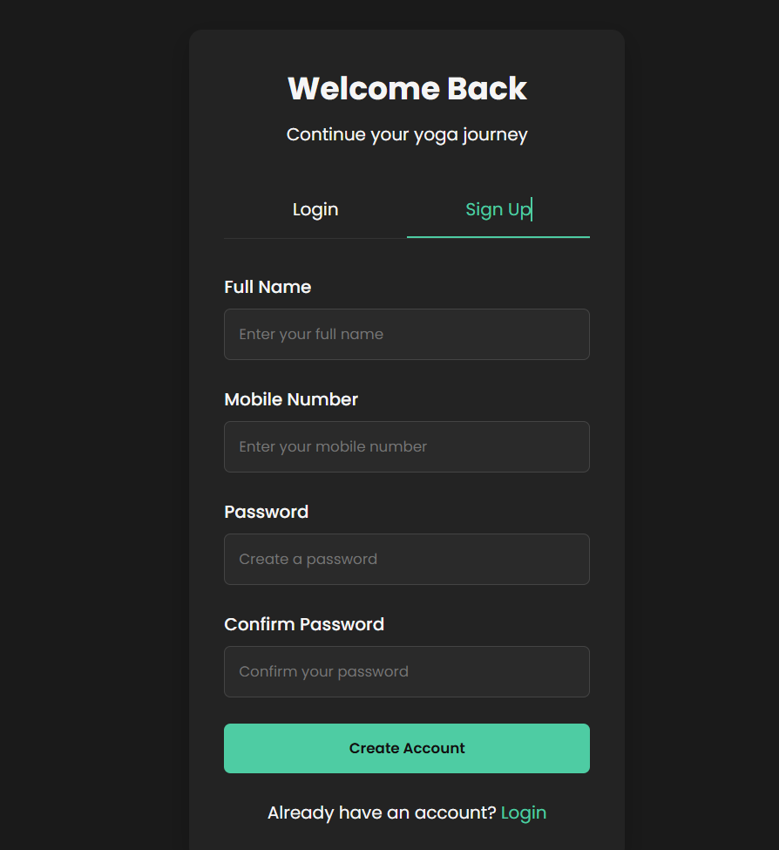
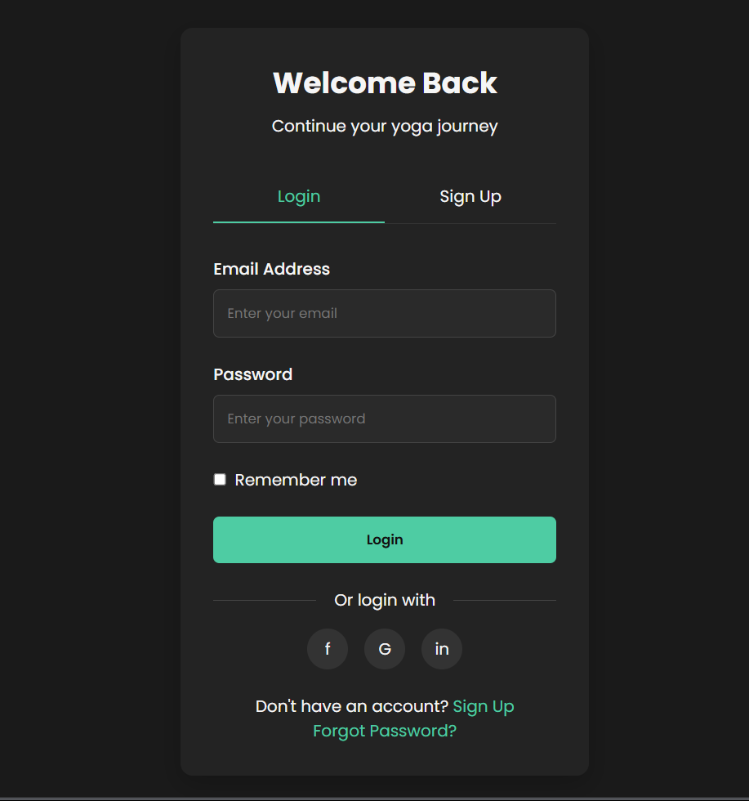
Login Page
A Remember Me Option to Save Login Details

Slide 6

Benefits of Yoga: Staying Fit with Our Website
Yoga is a great way to stay fit with our website. The sessions are carefully designed. You can achieve better flexibility.
Yoga promotes mental wellbeing and improved sleep. You can use our site to get fit. With the right yoga exercise, you will get better overall health.
Flexibility
Mental Well-being
Enhance your flexibility with yoga.
Promotes mental wellbeing with improved sleep.
Overall Health
With the right yoga, you'll improve your overall health.

Slide 7
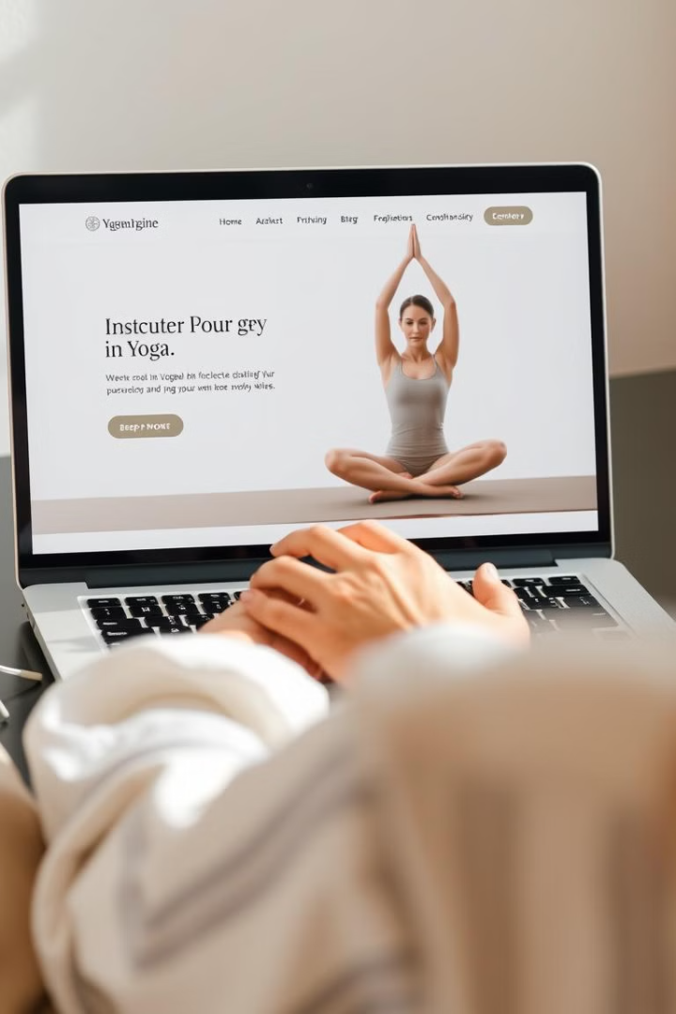
Website Demo: Navigating Your Fitness Journey
Explore how to use our yoga website. Discover personalized exercises and sessions. Find your perfect asana using our platform.
Our platform makes fitness journey fun. Get the hang of our navigation. Stay motivated using our support systems.
1
Personalized Exercise
Explore personalized sessions for all levels.
2
Asana
Find asana that helps you achieve your goals.
3
Support Systems
Stay motivated with our support systems.

Slide 8
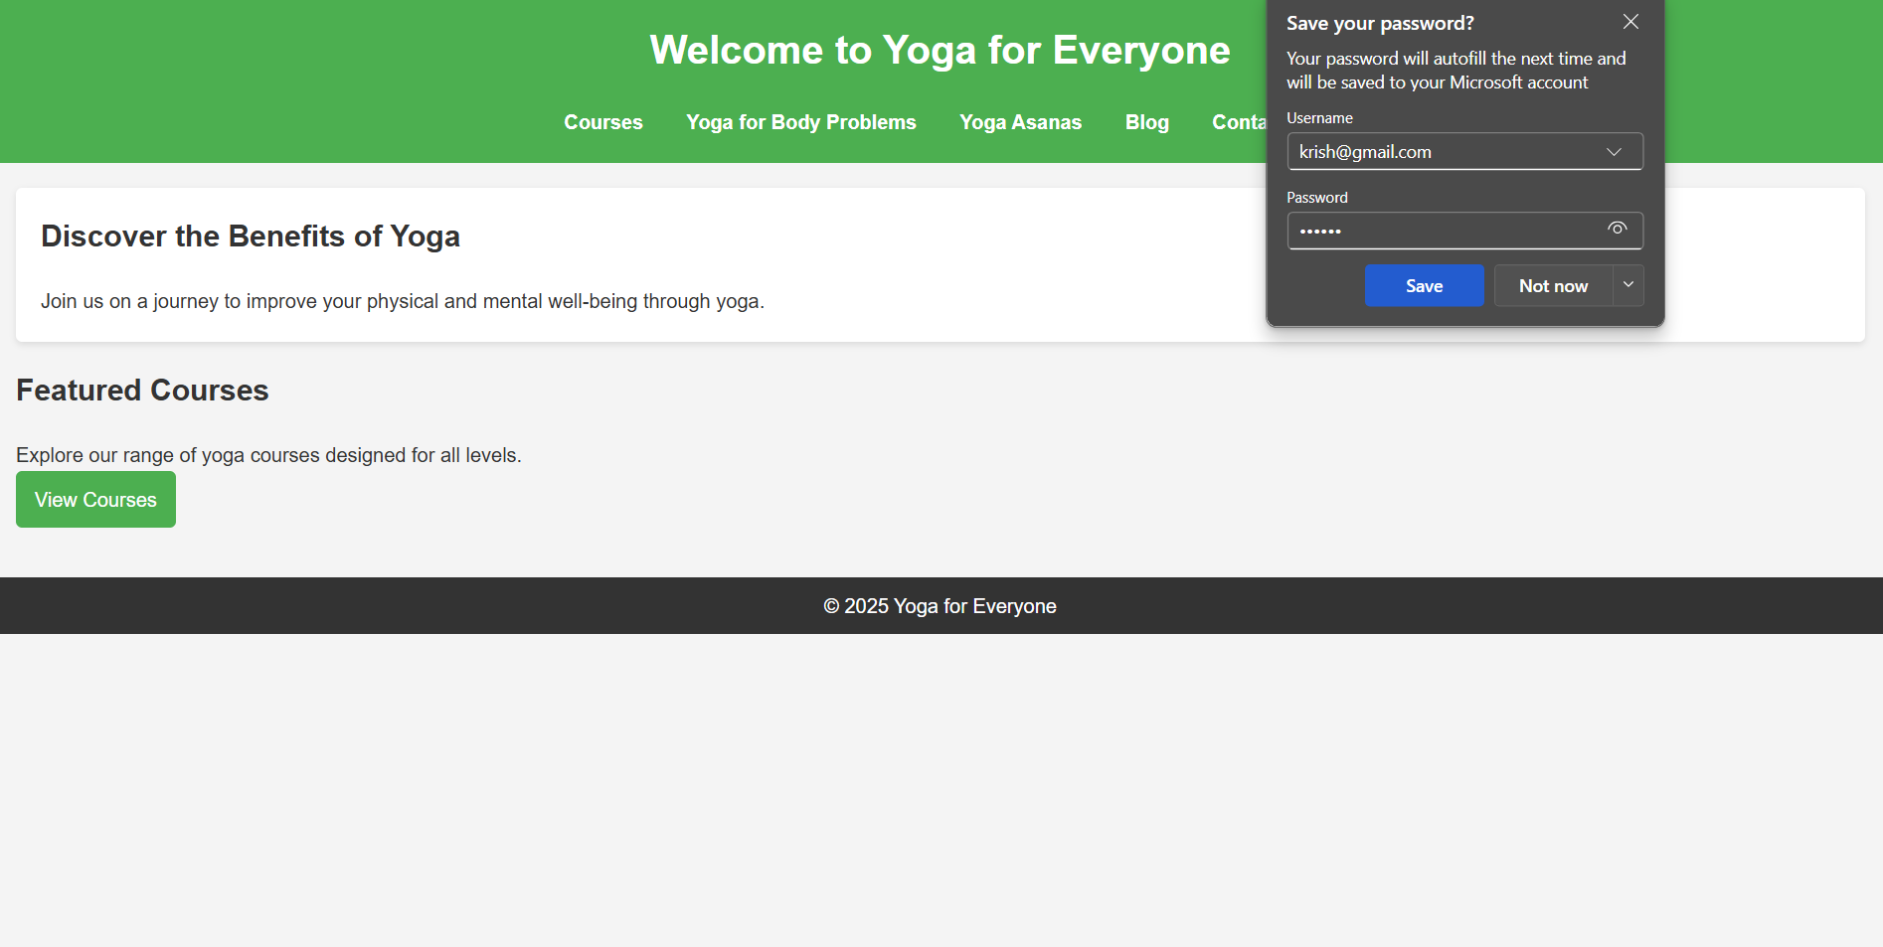
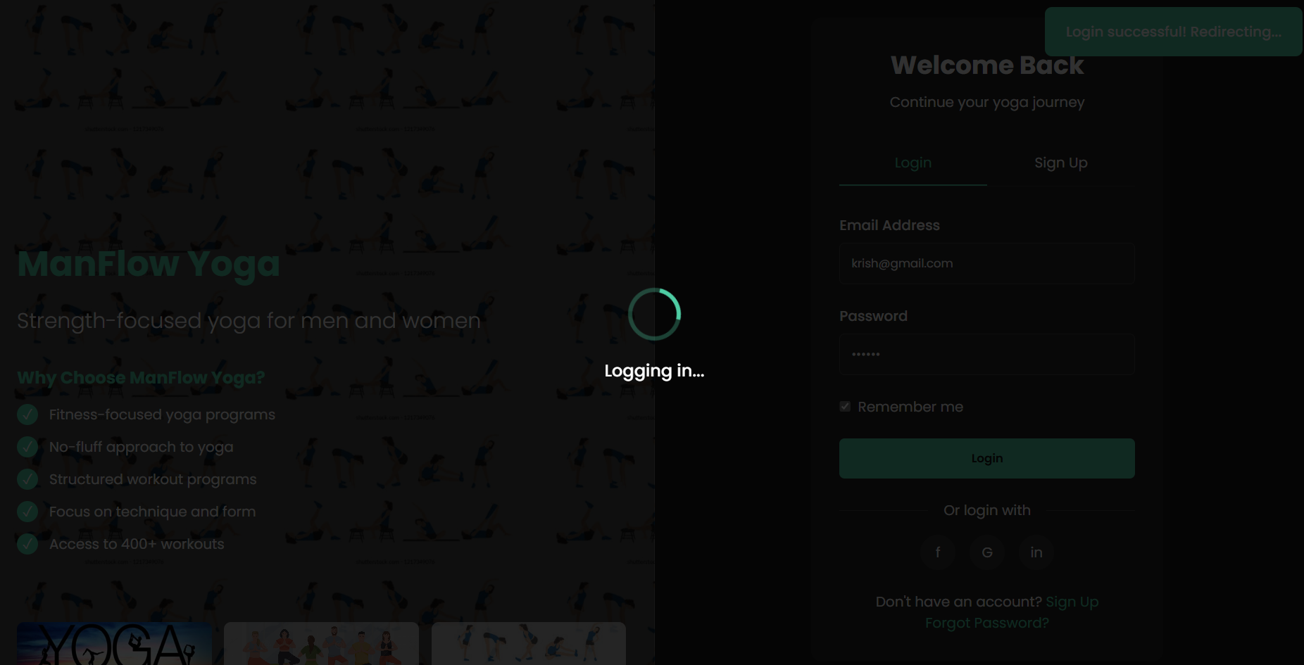
Home Page
file:///D:/jatin/DT%20GROUP%204/web.html
file:///D:/jatin/DT%20GROUP%204/web.html

Slide 9
https://yoga.ayush.gov.in/YAP/YB/Yoga-Billboard/Videos?lang=en
https://ayush.gov.in/#!/websitepolicies
And my personal videos

